Slide 1
Bitcoin and Blockchain

Slide 2
Overview
Bitcoin address
Bitcoin transactions
Locking and unlocking script
Blocks and Bitcoin mining
Blockchain

Slide 3
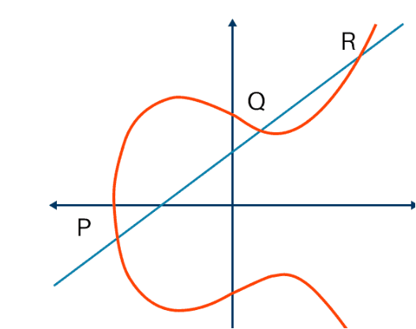

Public key and Private key
P+W=S
W
Elliptic Curve
S
Fix a point P=(x₀, y₀) on the curve (i.e., P satisfies the equation)
Public Key: Q=d*P, a point on the curve.
(* is a magic operator s.t. it is hard to find d using P, Q).
private key: d

Slide 4
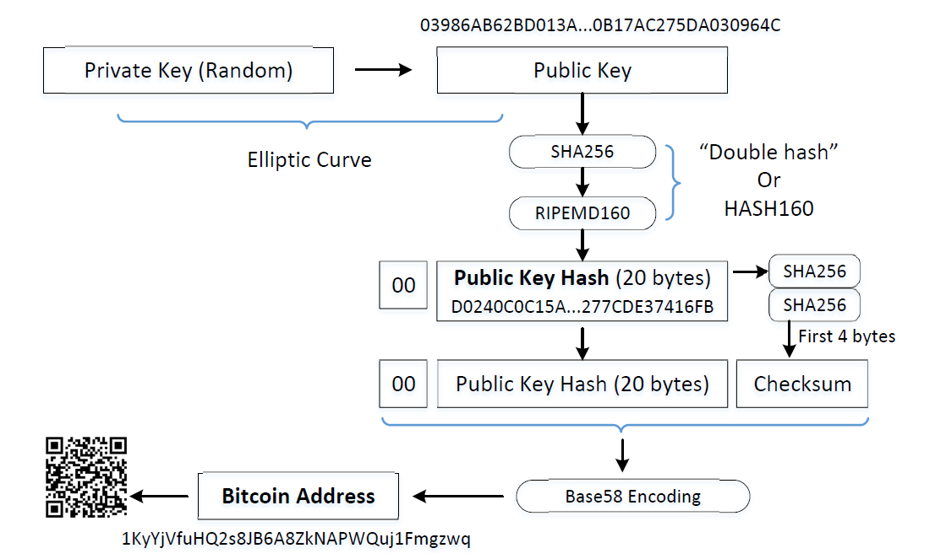

Turn Public-Key into Bitcoin Address
Bitcoin address generation: http://gobittest.appspot.com/Address

Slide 5
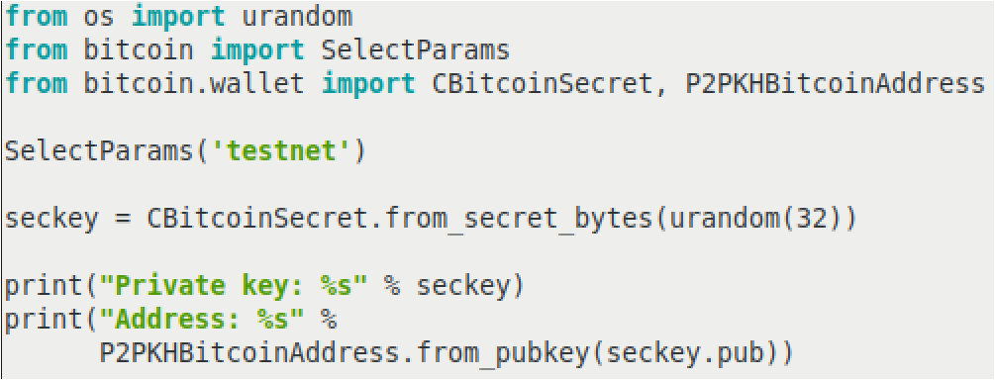
Generate keys and address from python
Bitcoin programming documentation: https://bitcoin-boh.readthedocs.io/en/latest/bitcoin.html
keygen.py
Indicate address starts with 6F
32 byte secret
object holding your bitcoin address

Slide 6
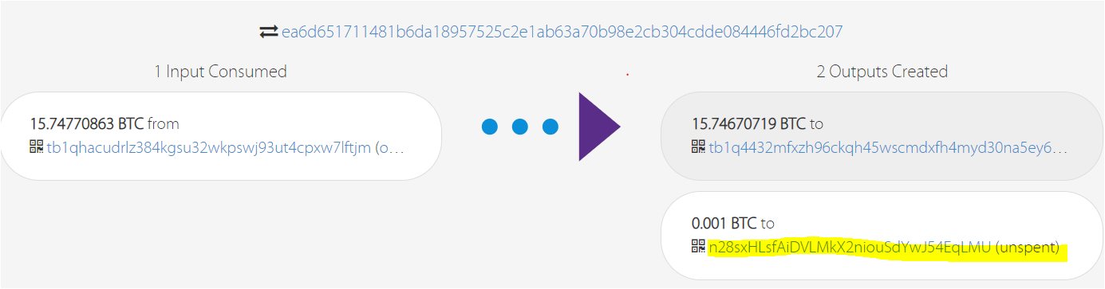
obtain test bitcoins via transaction from faucet
Go to https://testnet-faucet.com/btc-testnet/
paste your bitcoinaddress generated by keygen.py (limit to one time per hour)
You address will receive some bitcoin (to be confirmed in a few minuates).
(see your transaction at live.blockcypher.com)
Transaction ID
receiver Address
Sender Address

Slide 7
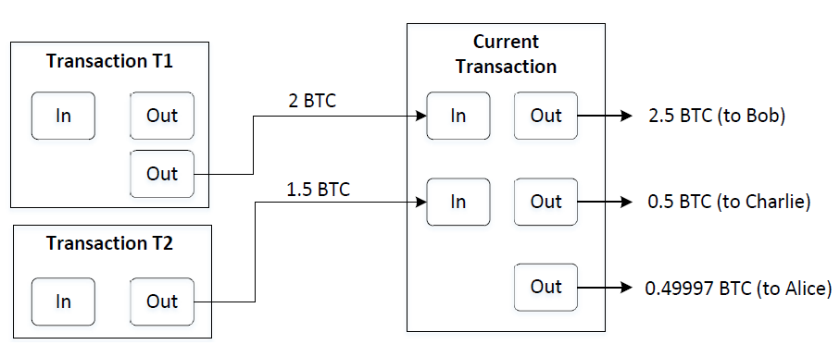
Transaction tx: example
to alice
Changes
Transaction fee = (2 + 1.5) – (2.5 + 0.5 + 0.49997) = 0.00003 BTC

Slide 8
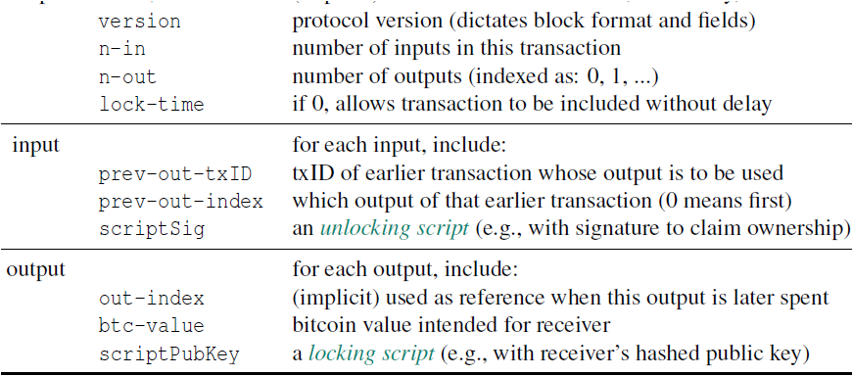
General Transaction format(https://en.bitcoin.it/wiki/Transaction)
txID=
Hash
Transaction-ID txID= SHA256 (SHA256 (the whole transaction data))

Slide 9
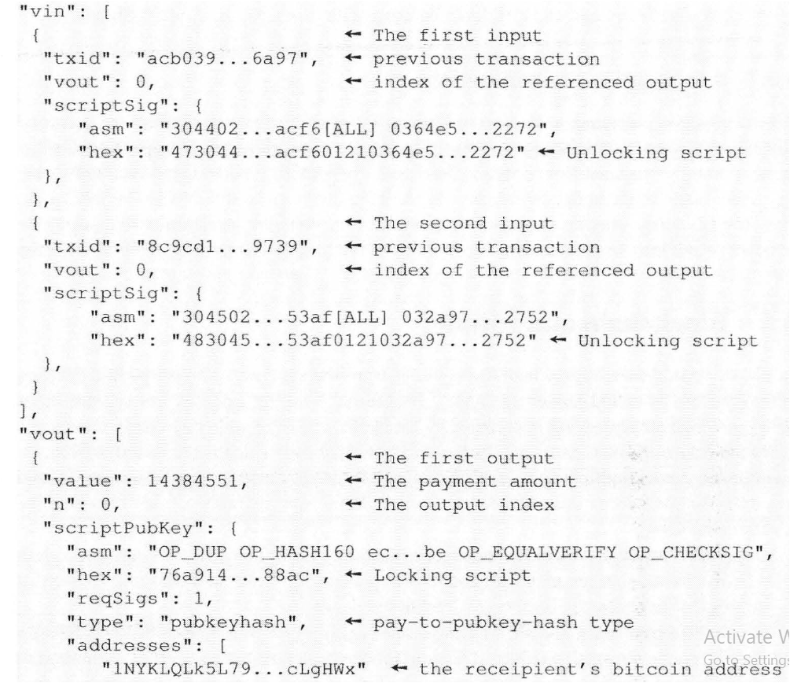
Input and output in a transaction
mainly digital signature
Tell interpreter to put 47 bytes to stack
in Satoshi (1BTC=10⁸ Satoshi)
, mainly signature public key

Slide 10
Locking/Unlocking Script: how to use bitcoins to pay?
Transaction txID1
Out 0 (for Alice)
(locking script 0)
in
mainly Bob’s public key:
whoever can provide signature consistent with locking script, can use BTC in out 1.
Out 1 (for Bob)
(locking script 1)
Transaction txID2
Bob’s signature
Out (for Tony)
In: txID1, index=1
unlocking_script_bob
Tony has to verify (unlocking_script_bob, locking_script_1) consistent
i.e., unlocking_script_bob is a signature of Bob.

Slide 11
Pay-to-PubKey-Hash (P2PKH): popular locking/unlocking script
LockingScript1 at txID1:
OP_DUP OP_HASH160 <PubKeyHash> OP_EQUALVERIFY OP_CHECKSIG
Unlocking_Script_Bob at txID2:
<signature> <public key>
To validate txID2, Tony will put them together and verify on the stack:
<signature><public key> OP_DUP OP_HASH160 <PubKeyHash> OP_EQUALVERIFY OP_CHECKSIG
How to understand and verify on a stack:
Explain: https://en.bitcoin.it/wiki/Script
Hands-on Practice: https://siminchen.github.io/bitcoinIDE/build/editor.html
8 6 op_2dup op_add e op_equalverify op_sub 2 op_equalverify
Notes:
Note to instructor: using a board or drawing directly on the slide to show how the script execute

Slide 12
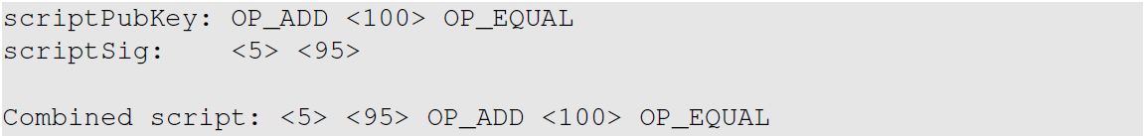
Scripting Evaluation Examples

Slide 13
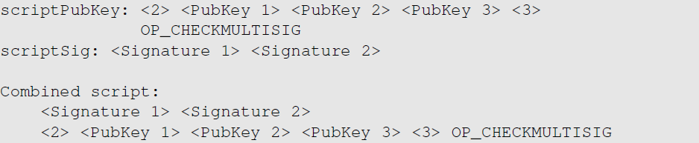
Pay-to-MultiSig (P2MS)

Slide 14
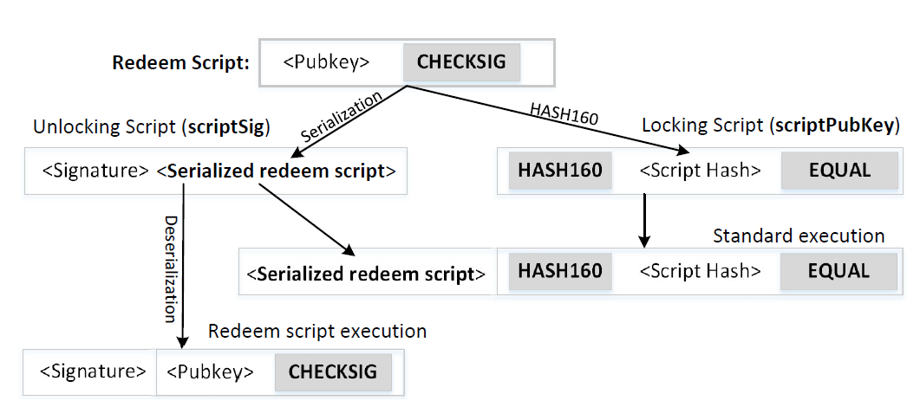
Pay-to-Script-Hash (P2SH)

Slide 15
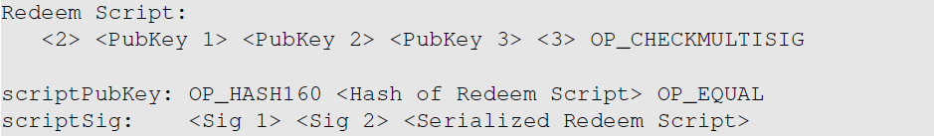
Use P2SH for MultiSig
Pay-to-MultiSig (P2MS)
Pay-to-Script-Hash (P2SH)

Slide 16
Sending Transaction
After a node has generated a transaction, it sends the transaction to the network
Each peer will verify the transaction, and then forward it to their peers
Eventually, every node on the network will receive the transaction
Some special node called miner will be responsible for adding the transaction to the public ledger (i.e., blockchain).

Slide 17
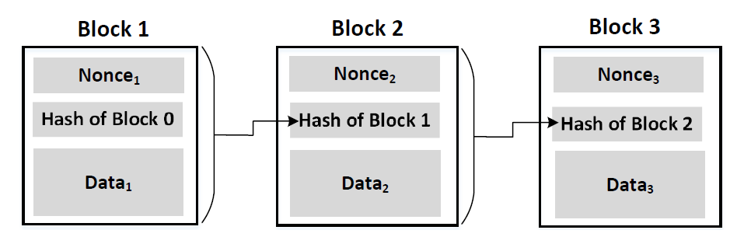
Generating Blocks
Miners group new transactions into a new block (e.g., Block 3).
The new block is appended to the existing blockchain

Slide 18
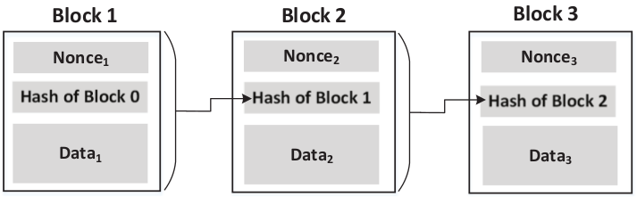
Blockchain: Make Chaining Difficult
Nonce is added to each block
Block hash must satisfy requirement (e.g. 20 leading zeros)
Since computation power will increase over time, number of leading zeros is intentionally increased over time (s.t. it still takes 10min to find and add a new block into the blockchain).

Slide 19
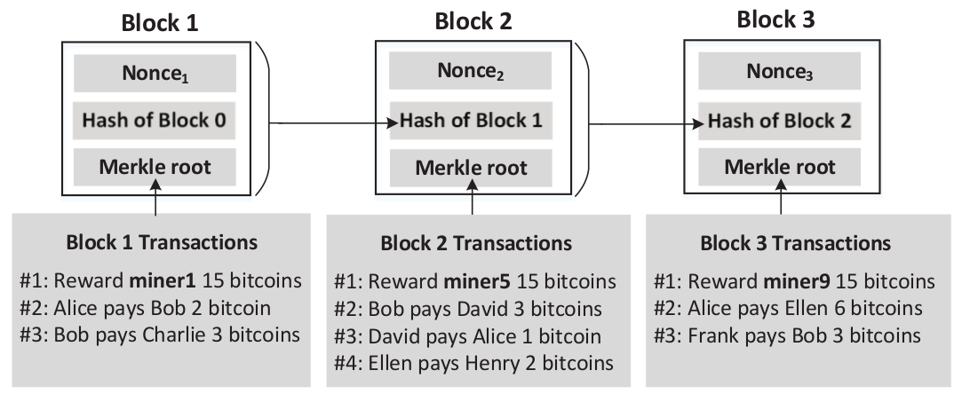
many transactions included in a new block
transactions

Slide 20
Mining
Proof-of-Work: find a nonce, s.t. when the hash of the block satisfies a special requirement, such as having 20 leading zeros
Rewarding:
Coinbase transaction: new bitcoins are mined and given to the miner (currently, worth 6.25 BTC)
Transaction fees
Once a miner has found a block, it immediately sends the block to its peers, who will verify the block and then forward the block to their peers.
Eventually, all the nodes will see this new block, and add it to their ledgers.

Slide 21
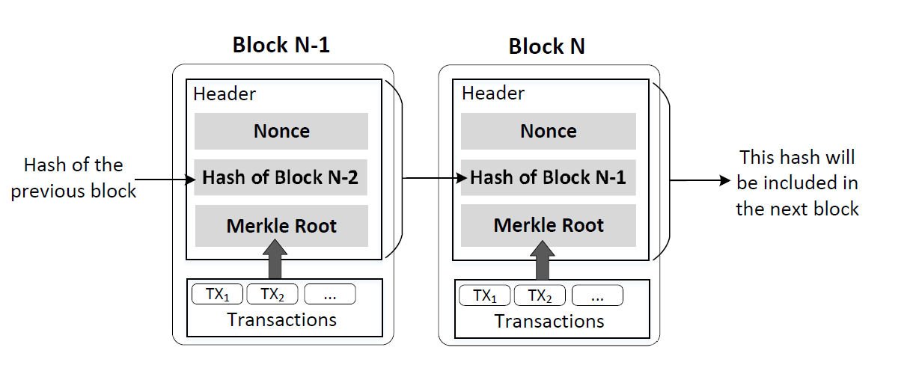
Include Merkle Root in Block
Hash of Block i is called Block_Hash
Notes:
Block_Hash is Hash256(Hash256(header)), similar to txID.

Slide 22
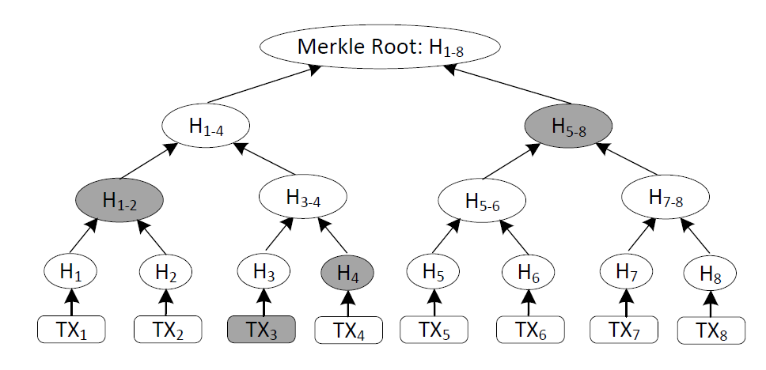
Merkle Tree
Benefit:
To find whether a transaction is included in a block, you don’t need all the transactions
Good for non-full nodes (who do not download the complete information of blockchain)

Slide 23
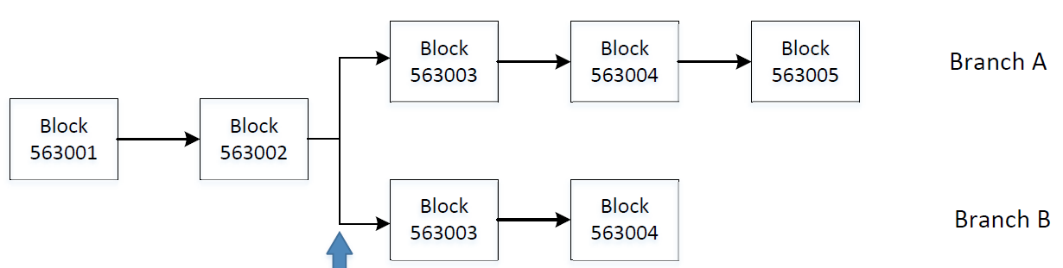
Branching
Each node on the bitcoin network has a blockchain from received blocks.
It is possible a node receives two blocks with the same previous block.
Policy: Miner mines a new block always pointing to the tail of the longest chain.
New block
Branching occurs when two valid blocks are found about the same time
The longest chain wins

Slide 24
Double Spending
If I bought a car via tx1 in block563003 of Branch B, I can use the coin in the input of tx1 to buy a boat in a tx2. I can do this since Branch B is abandoned by every node. So my double spending is OK.
New block

Slide 25
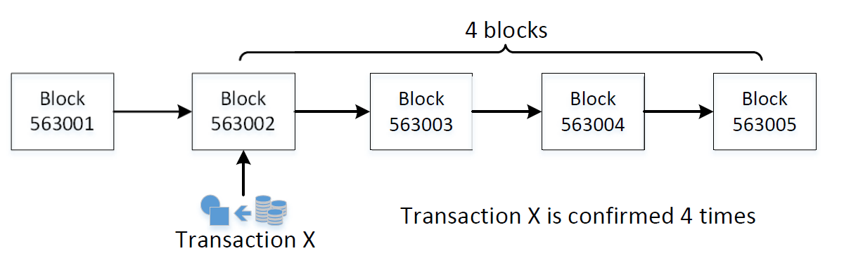
Confirmation Number
To avoid double spending, a tx receiver will wait for the block (containing his tx) to be followed by many blocks. In this case, receiver will be confident that his tx will be on the longest chain.
The larger a block’s confirmation number is, the less likely it will be removed from the blockchain (i.e., blockchain including his tx is shorter than another chain later).

Slide 26
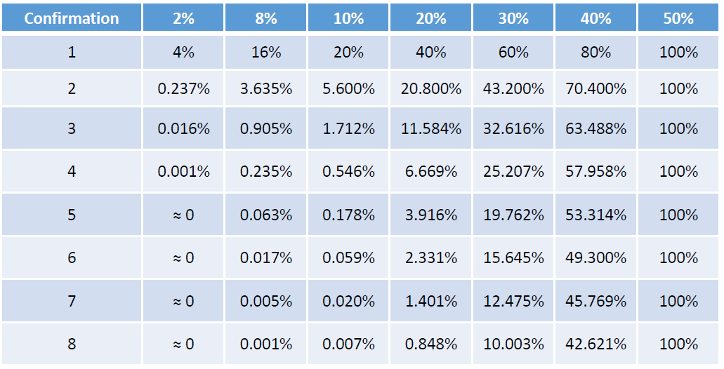
Probability of Double Spending
Attacker’s hash power
Attacker can always double spends if it has 50% hash power of all nodes in the blockchain network

Slide 27
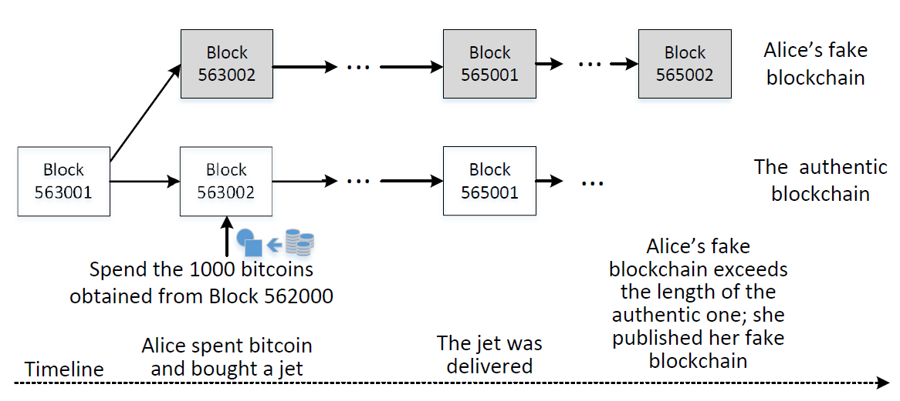
Double Spending with Majority Hash Power

Slide 28
Summary
Bitcoin address
Transactions, locking and unlocking script
Bitcoin mining
Blockchain, branching, confirmation number, and double spending

